Slide 1
vSpace-Function Tracer V2.0
Design & Demo
kaichen@univista-isg.com
2023/8/4

Slide 2
Requirements & Sample
Design
Implement
Demostration

Slide 3
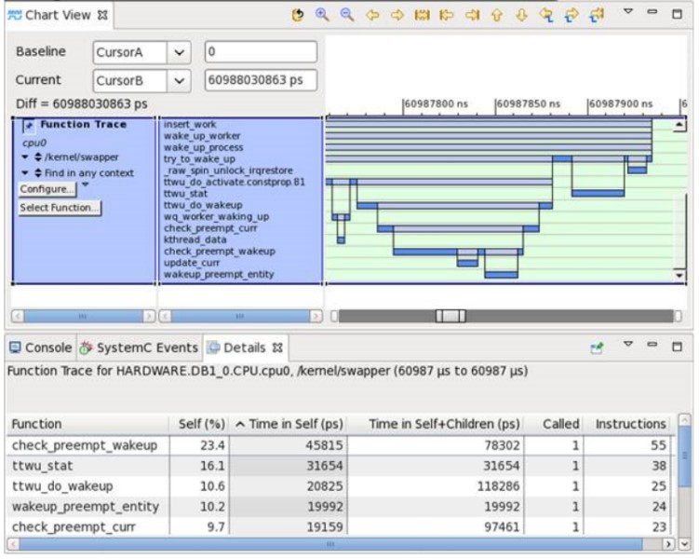
Requirements & Sample
Dashboard Content
Sample
%time: occupying time percentage of a specific function
cumulative seconds: cumulative running time of a specific function
calls: function call times
name: function name
children: child function called by a specific function

Slide 4
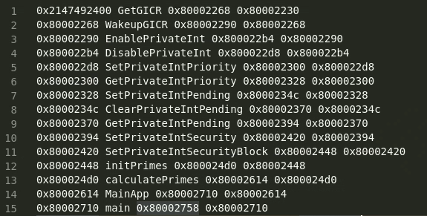
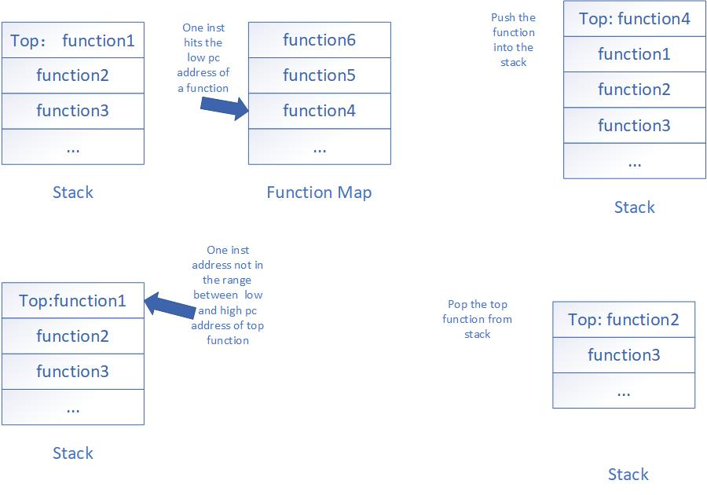
Design
1. Get function pc info
Generally we use drawfdump tool to generate the dwarf sections in object files with a human-readable form.
We use a regular expression to extract the information we need: high/low pc address of each function in the object file.
With the content we got above, we create a hash map with function’s low pc as key and function name and high pc as value. Every time we got a pc address access in running program, we can find out the address if it is the low pc address of a specific function.
2. Maintain a stack
When running a program we monite the address which it access every step. And in some case we will access and save the value stored in LR register.
We push a function's record in the top of Inst Stack(Simulation Stack) with its high pc, low pc, function name and the value in LR register right now.

Slide 5
Design
3. Process Algorithm
Get the address value of the current instruction as pc:
If the current pc is between lowPc~highPc of the function on the top of the stack, and the current pc is not in the lr register recorded by the function on the top of the stack Address:
then indicates that the current instruction is still executing the function content on the top of the stack, and does not do any operation:
else if the current pc satisfies the lowPc value of a certain function in the function Hashmap:
then indicates that the current instruction is a function call, record the corresponding lr register value, push it into the simulation stack together with the function information, and record a call operation;
else if the current pc satisfies the lR register value of a certain function record in the stack:
then indicates that the current instruction is a function return, and record all pops of the upper-level functions including this function, and record the return operation in turn;
else if the current pc satisfies the record in a function Hashmap but is not between the lowPc and highPc of the function of the simulated stack:
then indicates that the current instruction is executing the content of a function that is not in the simulation stack but is saved by the symbol table, indicating that the previous simulation stack information is lost, so the function is pushed into the stack as a compensation;
In order to avoid changes in lR caused by some such as longjump, it is necessary to monitor the change of the lR register at each call and process instruction, and update the change to the lR corresponding to the function on the top of the stack.

Slide 6
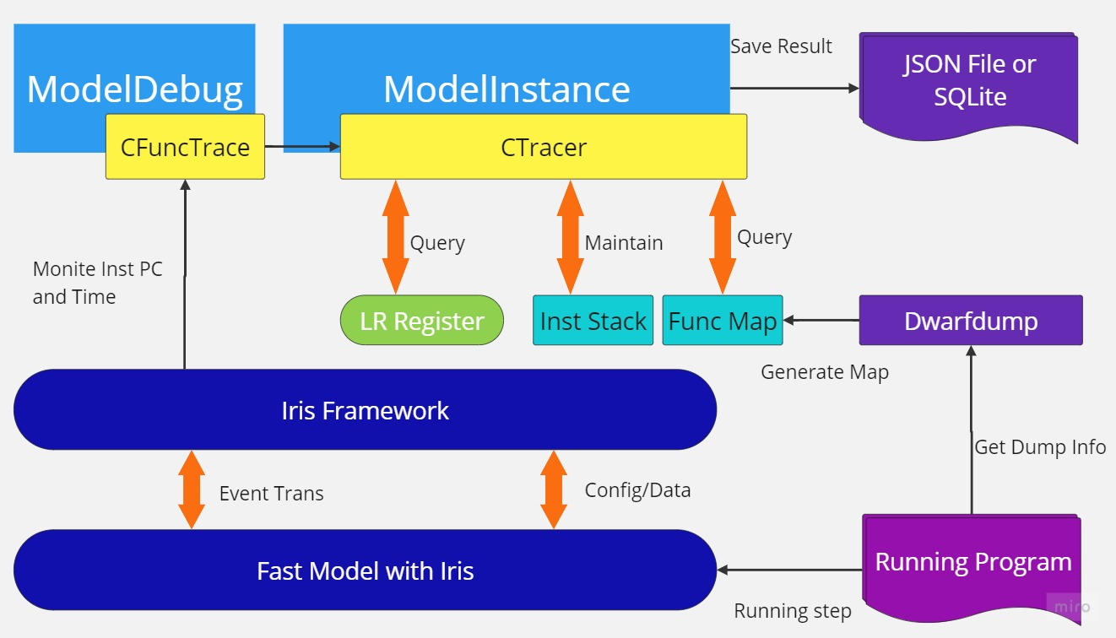
Implement

Slide 7
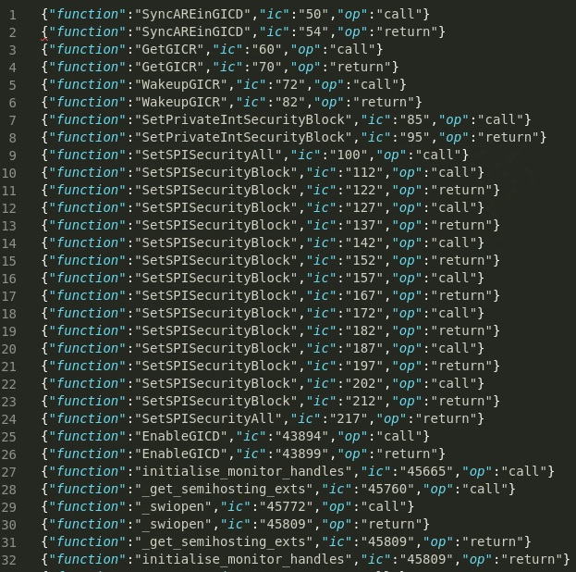
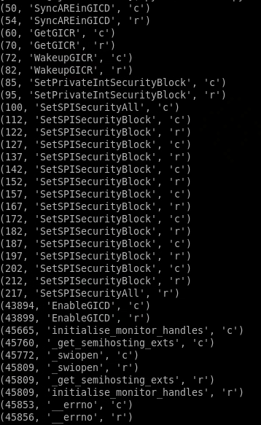
Demostration
Result as Json format
Result in SQLite

